Slide 1




Chapter 5:
A research perspective on Filecoin
Beginners Guide to Filecoin
Content created by Brown Zhang
Researcher @ KEN Labs

Slide 2

Intro
Filecoin network is launching in the middle of a revolution in internet architecture.
Filecoin represents an evolution in protocols and services adapted to the needs of the revolution in internet architecture.
Filecoin and other blockchain networks like Bitcoin and Ethereum are pioneering examples of Open Services.

Slide 3
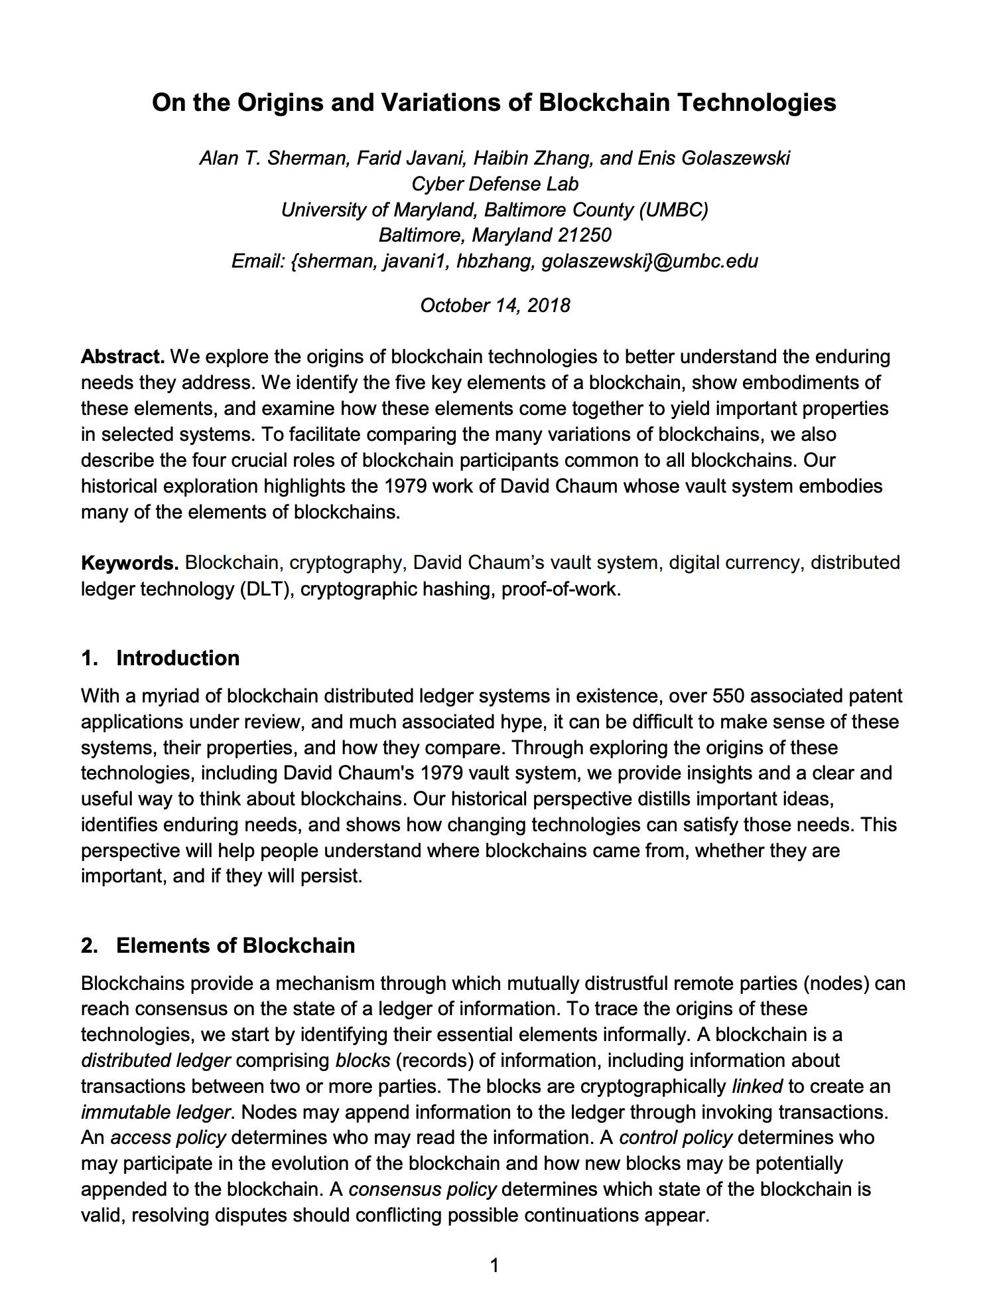
Standing on
the shoulders of giants
It would be impossible to capture all of the advances in cryptography, distributed systems, cryptoeconomics, and related fields that have contributed to the development of Filecoin.

Slide 4

The post-Bitcoin landscape
The arrival of Bitcoin initiated a rapid florescence in the development of distributed ledger technology, inaugurating the modern blockchain era. This period saw a number of innovations in both underlying technologies and overlaid applications.
Bitcoin’s practical breakthrough was its proof-of-work consensus algorithm, which created a reliable system for managing and tracking token ownership in a distributed system. It was established that satisfactory solutions to the Byzantine Generals' problem were realistically possible.

Slide 5

The post-Bitcoin landscape
Blockchain developers immediately began to implement further innovations on the problem of consensus.
Such as: Peercoin, Primecoin, and Permacoin.
Ethereum (whitepaper, 2013) launched based on a proof-of-work consensus protocol (Ethash); the network intends to shift to a proof-of-stake protocol in Eth 2.0. Ethereum explicitly foregrounded the potential for blockchain networks to serve as a platform for decentralized applications, helping to create the market for decentralized file storage, among other novel blockchain applications.

Slide 6
The 2014 Filecoin whitepaper
The first version of Filecoin, a cryptocurrency and file storage network enabling the outsourcing of data storage to a distributed network of service providers, was published in 2014.
In the 2014 proposal, Filecoin’s useful storage service is layered atop Bitcoin-style proof-of-work consensus: in addition to solving a cryptographic puzzle, Filecoin miners would complete a proof-of-retrievability establishing that they were storing a particular file.

Slide 7
The 2017 Filecoin whitepaper
The Filecoin Proof System
The 2017 Filecoin construction described two new proofs-of-storage:
proof-of-replication (PoRep)
proof-of-spacetime (PoSt)
In 2017, Protocol Labs announced Filecoin, the decentralized storage network, and market first envisioned in the 2014 whitepaper.
Compared with the 2014 filecoin white paper, several significant conceptual and technological advances have been added:
2
IPFS
In 2015, the launch of IPFS — a peer-to-peer hypermedia protocol for storing and sharing data in a distributed file system.
Refactoring Consensus
Filecoin’s leader elections and its block reward system based on useful work create a system of incentives aligning miners and clients, with the goal of the network: providing useful storage.
1
3

Slide 8

Drand
Filecoin requires high-entropy, unbiased, publicly verifiable, and unpredictable randomness to conduct the leader elections, which determine which miner will generate the next block on the blockchain and earn that block’s rewards, and for the generation of PoRep and PoSt.
Drand provides this “good randomness”, allowing Filecoin to guarantee liveness — client consensus on the history of the Filecoin blockchain — and verifiable storage.

Slide 9
Building the future
The Filecoin network exploded onto the blockchain scene in October 2020, introducing an exciting new configuration of technology and incentives to the nascent Web 3.0 space.
Predicting — and shaping — the trajectory of new technology is a complex process.
Protocol Labs researchers have some ideas about research areas that might be interesting to watch in the future:
zk-SNARKs, VRFs, VDFs, Depth Robust Graphs, Vector Commitments, and BLS signatures
aiming to enhance scalability, integrity verification, and cryptographic primitives.

Slide 10
Conclusion
The Filecoin research community drives breakthroughs that will accelerate the evolution of the Filecoin network. But the real technological accelerant will be Filecoin’s ongoing widespread adoption by the broader Web 3.0 community, bringing research into contact with reality to create new technologies and applications.

Slide 11


Feedback is welcomed.
https://github.com/kenlabs/Beginners-Guide-to-Filecoin

